Slide 1
Lecture 5 – Interrupt Basics, Edge-Triggered Interrupts and SysTick Interrupt
By Dr. Min He

Slide 2
Agenda
Interrupt: review concept
Interrupt Processing
Common interrupt mechanisms
ARM Cortex M4 interrupt programming: arm, enable, trigger, vector, priority, acknowledge.
Edge Triggered Interrupts
SysTick Periodic Interrupt
CECS347

Slide 3
Interrupts
An interrupt is the automatic transfer of software execution in response to a hardware event (trigger) that is asynchronous with current software execution.
  external I/O device (like a keyboard or printer) or
  an internal event (like an op code fault, or a periodic timer.)
Occurs when the hardware needs or can service (busy to done state transition)
CECS347
Notes:
An embedded system uses its input/output devices to interact with the external world. Input devices allow the computer to gather information, and output devices can display information. Output devices also allow the computer to manipulate its environment. The tight-coupling between the computer and external world distinguishes an embedded system from a regular computer system. The challenge is under most situations the software executes much faster than the hardware. E.g., it might take the software only 1 us to ask the hardware to clear the LCD, but the hardware might take 1 ms to complete the command. During this time, the software could execute tens of thousands of instructions. Therefore, the synchronization between the executing software and its external environment is critical for the success of an embedded system.

Slide 4
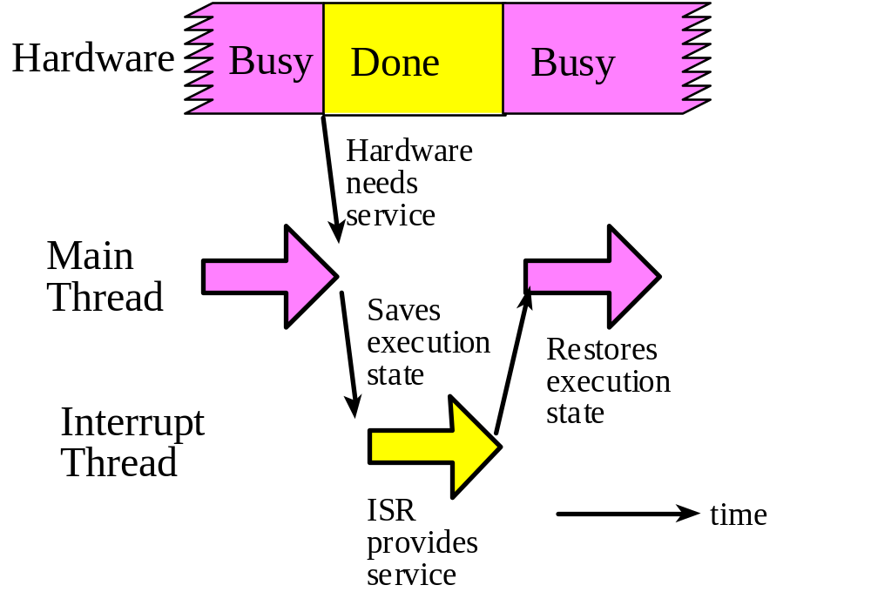
Interrupt Processing
A thread is defined as the path of action of software as it executes.
A hardware event is called a trigger.
CECS347
Notes:
The execution of the interrupt service routine is called a background thread. This thread is created by the hardware interrupt request and is killed when the interrupt service routine returns from interrupt (e.g., by executing a BX LR). A new thread is created for each interrupt request. It is important to consider each individual request as a separate thread because local variables and registers used in the interrupt service routine are unique and separate from one interrupt event to the next interrupt. In a multi-threaded system, we consider the threads as cooperating to perform an overall task. Consequently we will develop ways for the threads to communicate (e.g., FIFO) and to synchronize with each other.

Slide 5
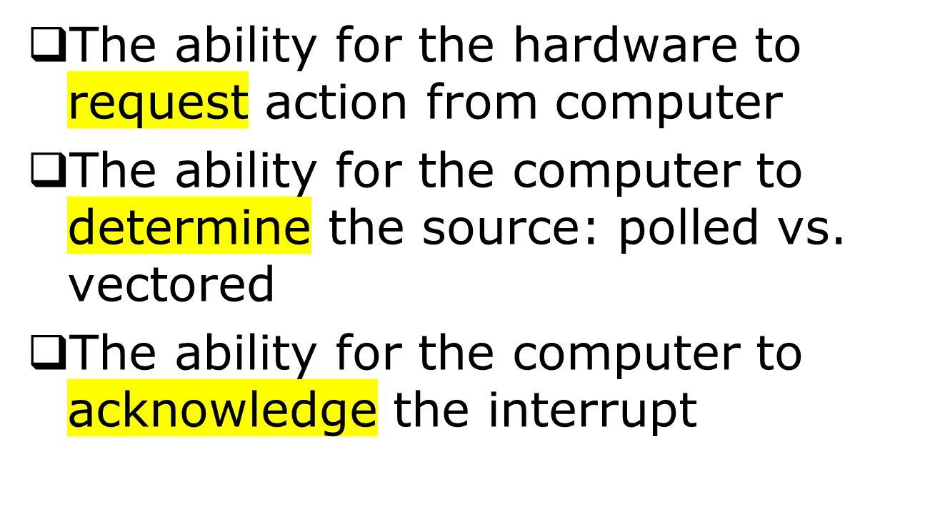
Common Interrupt Mechanisms
CECS347
Notes:
There are three essential mechanisms that are needed to utilize interrupts. Although every computer that uses interrupts includes all three mechanisms, how the mechanisms operate will vary from one computer to another.
All interrupting systems must have the ability for the hardware to request action from computer. In general, the interrupt requests can be generated using a separate connection to the processor for each device. The TM4C microcontrollers use separate connections to request interrupts.
All interrupting systems must have the ability for the computer to determine the source. A vectored interrupt system employs separate connections for each device so that the computer can give automatic resolution. You can recognize a vectored system because each device has a separate interrupt vector address. With a polled interrupt system, the interrupt software must poll each device, looking for the device that requested the interrupt. Most interrupts on the TM4C microcontrollers are vectored, but there are some triggers that share the same vector. For these interrupts the ISR must poll to see which trigger caused the interrupt. For example, all input pins on one GPIO port can trigger an interrupt, but the trigger flags share the same vector. So if multiple pins on one GPIO port are armed, the shared ISR must poll to determine which one(s) requested service.
The third necessary component of the interface is the ability for the computer to acknowledge the interrupt. Normally there is a trigger flag in the interface that is set on the busy to ready state transition. In essence, this trigger flag is the cause of the interrupt. Acknowledging the interrupt involves clearing this flag. It is important to shut off the request, so that the computer will not mistakenly request a second (and inappropriate) interrupt service for the same condition. Except for periodic SysTick interrupts, TM4C microcontrollers use software acknowledge. So when designing an interrupting interface, it will be important to know exactly what hardware condition sets the trigger flag (and request an interrupt) and how the software will clear it (acknowledge) in the ISR.

Slide 6
Polled vs. Vectored Interrupts
A vectored interrupt system employs separate connections for each device so that the computer can give automatic resolution.
In a polled interrupt system, the interrupt software must poll each device, looking for the device that requested the interrupt.
Most interrupts on the TM4C microcontrollers are vectored, but there are some triggers that share the same vector. Ex: GPIO Ports.
CECS347
Notes:
A vectored interrupt system employs separate connections for each device so that the computer can give automatic resolution. You can recognize a vectored system because each device has a separate interrupt vector address.
In a polled interrupt system, the interrupt software must poll each device, looking for the device that requested the interrupt.
Most interrupts on the TM4C microcontrollers are vectored, but there are some triggers that share the same vector.
Example for vectored interrupts: systick periodic interrupt is a vectored interrupt, a unique interrupt vector address is assigned to it, which is SysTick_Handler at program ROM location 0x0000003C. The interrupt vector table can be found in program ROM start at memory location 0x00000008.
Example for polled interrupts, all input pins on one GPIO port can trigger an interrupt, but the trigger flags share the same vector. So if multiple pins on one GPIO port are armed, the shared ISR must poll to determine which one(s) requested service.

Slide 7
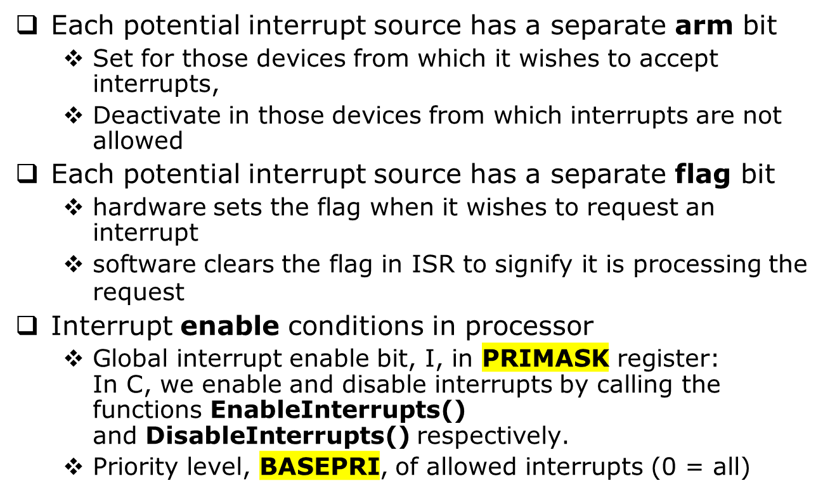
ARM Cortex-M Interrupts
Software Controls
CECS347
Notes:
To arm a device means to allow the hardware trigger to interrupt. Conversely, to disarm a device means to shut off or disconnect the hardware trigger from the interrupts. Each potential interrupting trigger has a separate arm bit. One arms a trigger if one is interested in interrupts from this source. Conversely, one disarms a trigger if one is not interested in interrupts from this source. To enable means to allow interrupts at this time. Conversely, to disable means to postpone interrupts until a later time. On theARM Cortex-M processor there is one interrupt enable bit for the entire interrupt system. We disable interrupts if it is currently not convenient to accept interrupts. In particular, to disable interrupts we set the I bit in PRIMASK. In C, we enable and disable interrupts by calling the functions EnableInterrupts()and DisableInterrupts() respectively.
For most devices there is a enable bit in the NVIC that must be set (periodic SysTick interrupts are an exception, having no NVIC enable).
The BASEPRI register prevents interrupts with lower priority interrupts, but allows higher priority interrupts. For example if the software sets the BASEPRI to 3, then requests with level 0, 1, and 2 can interrupt, while requests at levels 3 and higher will be postponed. The software can also specify the priority level of each interrupt request. If BASEPRI is zero, then the priority feature is disabled and all interrupts are allowed.

Slide 8
Interrupt Conditions
Five conditions must be true simultaneously for an interrupt to occur:
  Arm: control bit for each possible source is set
  NVIC enable
  Enable: interrupts globally enabled (I=0 in PRIMASK)
  Level: interrupt level must be less than BASEPRI
  Trigger: hardware action sets source-specific flag
Interrupt remains pending if trigger is set but any other condition is not true
  Interrupt serviced once all conditions become true
Need to acknowledge interrupt
  Clear trigger flag in ISR or will get endless interrupts!
CECS347
Notes:
Five conditions must be true for an interrupt to be generated:
1) device arm,
2) NVIC enable,
3) global enable,
4) interrupt priority level must be higher than current level executing, and
5) hardware event trigger.
For an interrupt to occur, these five conditions must be simultaneously true but can occur in any order.
Clearing a trigger flag is called acknowledgement, which occurs only by specific software action. Each trigger flag has a specific action software must perform to clear that flag. We will pay special attention to these enable/disable software actions. The SysTick periodic interrupt will be the only example of an automatic acknowledgement. For SysTick, the periodic timer requests an interrupt, but the trigger flag will be automatically cleared when the ISR runs. For all the other trigger flags, the ISR must explicitly execute code that clears the flag.

Slide 9
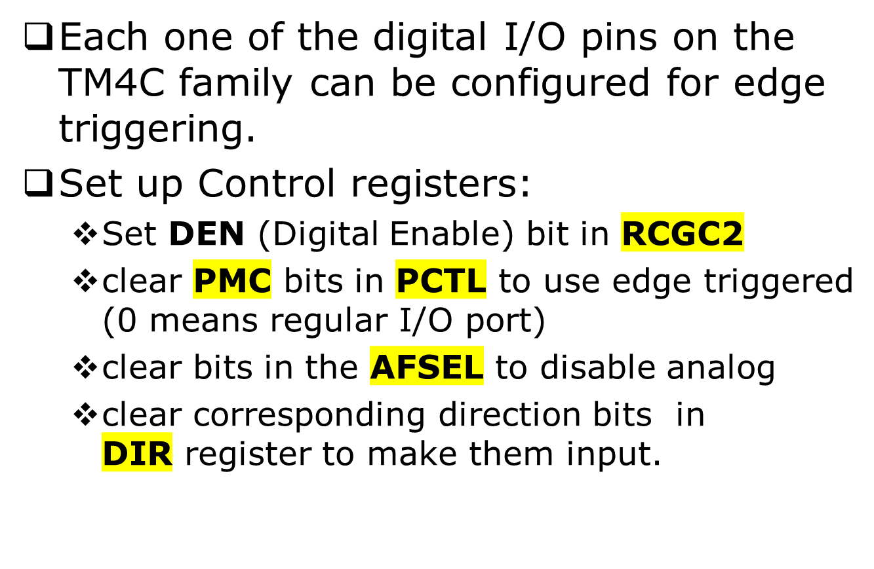
Edge-Triggered
CECS347
Notes:
Synchronizing software to hardware events requires the software to recognize when the hardware changes states from busy to done.

Slide 10
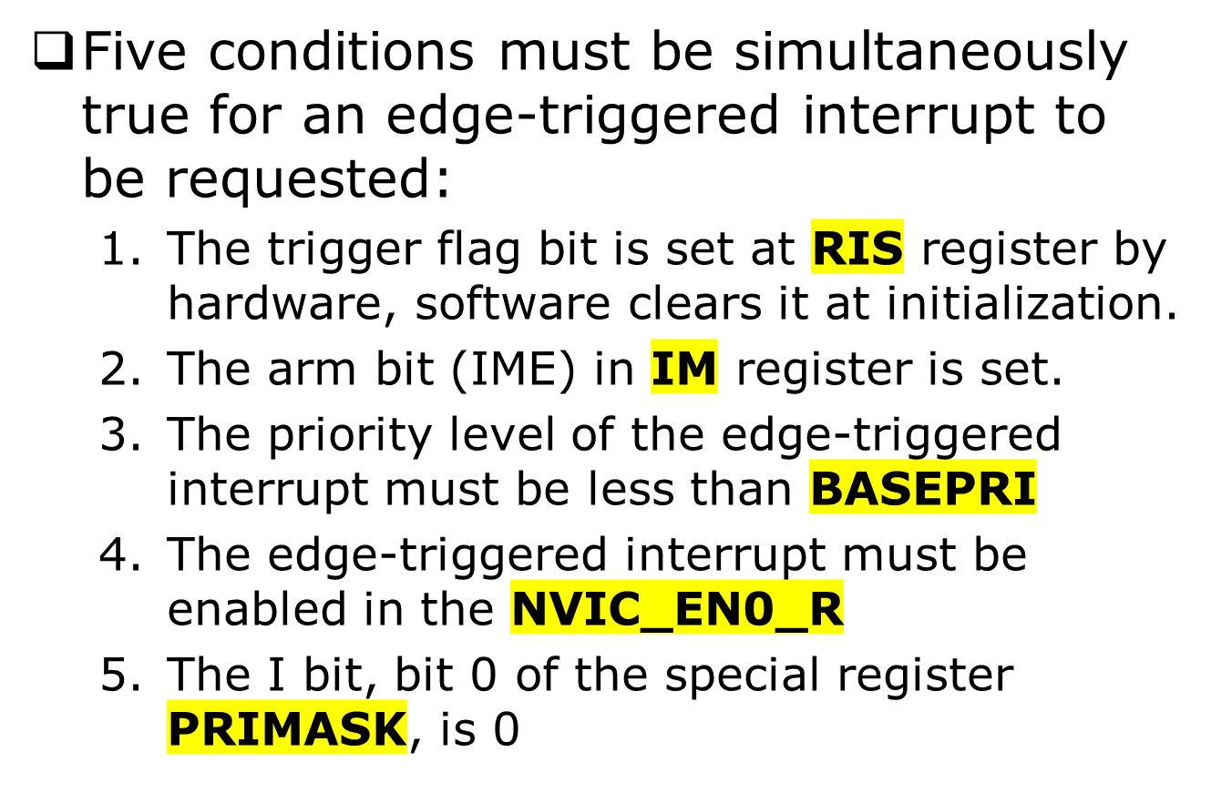
Edge Triggered Interrupts
CECS347

Slide 11
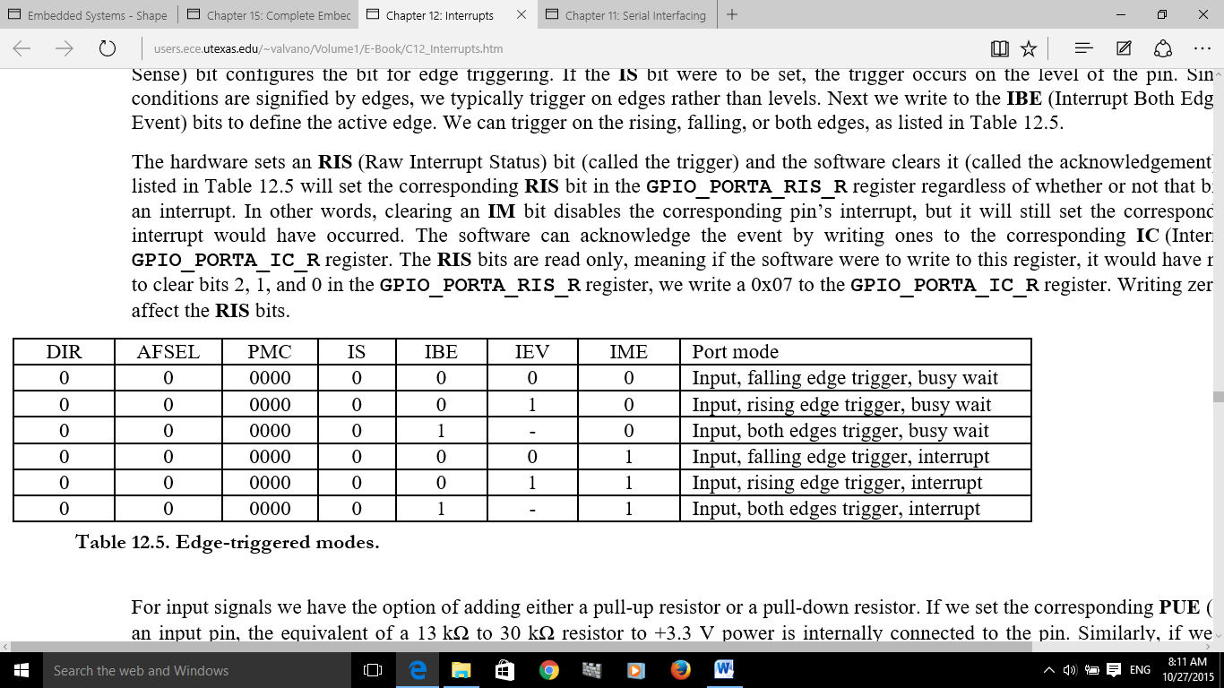
Edge-triggered Interrupt Modes
set IME=1 to arm interrupt.
CECS347

Slide 12
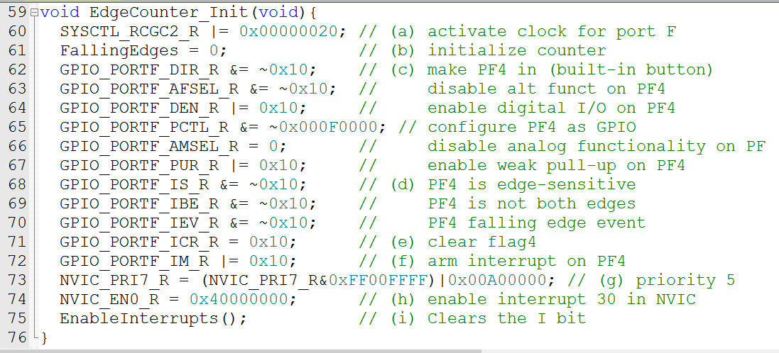
EdgeInterrupt.c: EdgeCounter_Init()
CECS347

Slide 13
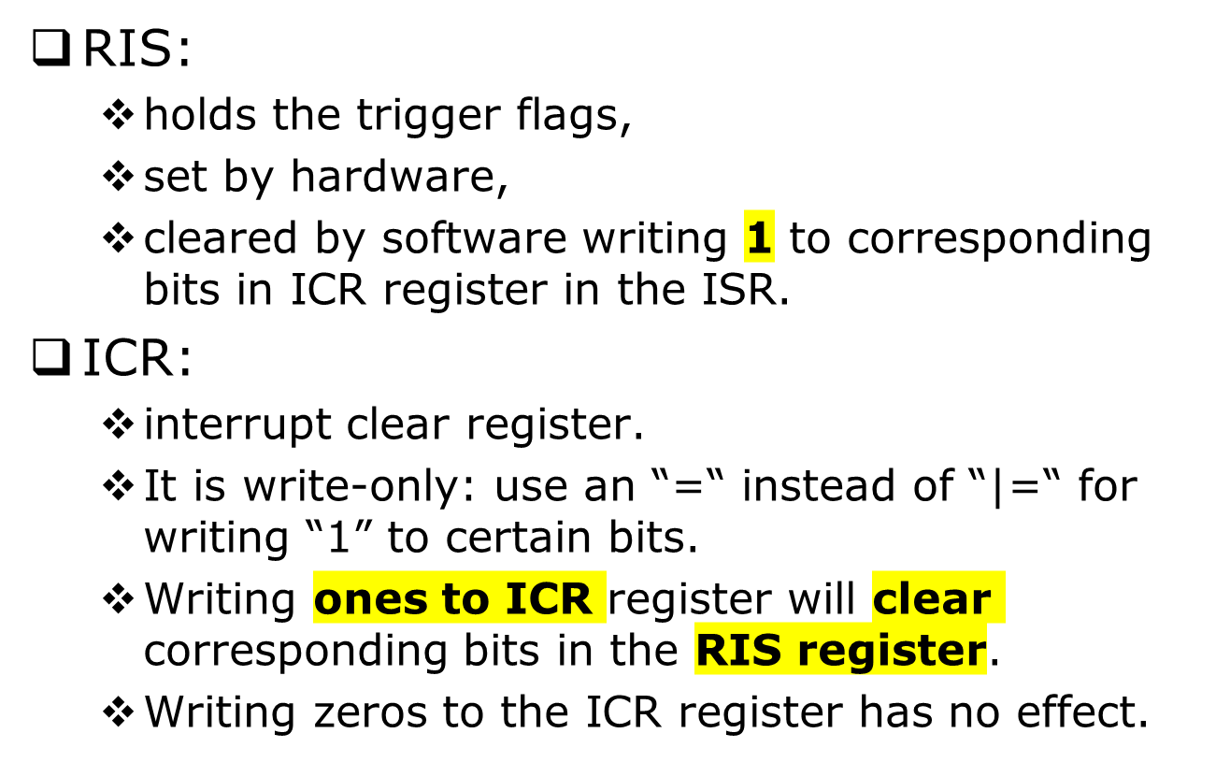
The Role of ICR/RIS Registers
CECS347

Slide 14
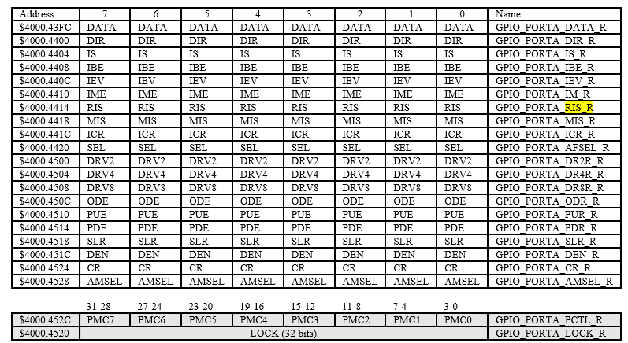
CECS347

Slide 15
Vector address
Number
IRQ
ISR name in Startup.s
NVIC
Priority bits
77 total
0x00000038
14
-2
PendSV_Handler
NVIC_SYS_PRI3_R
23 – 21
0x0000003C
15
-1
SysTick_Handler
NVIC_SYS_PRI3_R
31 – 29
0x00000040
16
0
GPIOPortA_Handler
NVIC_PRI0_R
7 – 5
0x00000044
17
1
GPIOPortB_Handler
NVIC_PRI0_R
15 – 13
0x00000048
18
2
GPIOPortC_Handler
NVIC_PRI0_R
23 – 21
0x0000004C
19
3
GPIOPortD_Handler
NVIC_PRI0_R
31 – 29
0x00000050
20
4
GPIOPortE_Handler
NVIC_PRI1_R
7 – 5
0x00000054
21
5
UART0_Handler
NVIC_PRI1_R
15 – 13
0x00000058
22
6
UART1_Handler
NVIC_PRI1_R
23 – 21
0x0000005C
23
7
SSI0_Handler
NVIC_PRI1_R
31 – 29
0x00000060
24
8
I2C0_Handler
NVIC_PRI2_R
7 – 5
0x00000064
25
9
PWMFault_Handler
NVIC_PRI2_R
15 – 13
0x00000068
26
10
PWM0_Handler
NVIC_PRI2_R
23 – 21
0x0000006C
27
11
PWM1_Handler
NVIC_PRI2_R
31 – 29
0x00000070
28
12
PWM2_Handler
NVIC_PRI3_R
7 – 5
0x00000074
29
13
Quadrature0_Handler
NVIC_PRI3_R
15 – 13
0x00000078
30
14
ADC0_Handler
NVIC_PRI3_R
23 – 21
0x0000007C
31
15
ADC1_Handler
NVIC_PRI3_R
31 – 29
0x00000080
32
16
ADC2_Handler
NVIC_PRI4_R
7 – 5
0x00000084
33
17
ADC3_Handler
NVIC_PRI4_R
15 – 13
0x00000088
34
18
WDT_Handler
NVIC_PRI4_R
23 – 21
0x0000008C
35
19
Timer0A_Handler
NVIC_PRI4_R
31 – 29
0x00000090
36
20
Timer0B_Handler
NVIC_PRI5_R
7 – 5
INTERRUPT VECTORS
0x00000094
37
21
Timer1A_Handler
NVIC_PRI5_R
15 – 13
0x00000098
38
22
Timer1B_Handler
NVIC_PRI5_R
23 – 21
0x0000009C
39
23
Timer2A_Handler
NVIC_PRI5_R
31 – 29
0x000000A0
40
24
Timer2B_Handler
NVIC_PRI6_R
7 – 5
0x000000A4
41
25
Comp0_Handler
NVIC_PRI6_R
15 – 13
0x000000A8
42
26
Comp1_Handler
NVIC_PRI6_R
23 – 21
0x000000AC
43
27
Comp2_Handler
NVIC_PRI6_R
31 – 29
0x000000B0
44
28
SysCtl_Handler
NVIC_PRI7_R
7 – 5
0x000000B4
45
29
FlashCtl_Handler
NVIC_PRI7_R
15 – 13
0x000000B8
46
30
GPIOPortF_Handler
NVIC_PRI7_R
23 – 21
0x000000BC
47
31
GPIOPortG_Handler
NVIC_PRI7_R
31 – 29
0x000000C0
48
32
GPIOPortH_Handler
NVIC_PRI8_R
7 – 5
0x000000C4
49
33
UART2_Handler
NVIC_PRI8_R
15 – 13
0x000000C8
50
34
SSI1_Handler
NVIC_PRI8_R
23 – 21
0x000000CC
51
35
Timer3A_Handler
NVIC_PRI8_R
31 – 29
0x000000D0
52
36
Timer3B_Handler
NVIC_PRI9_R
7 – 5
0x000000D4
53
37
I2C1_Handler
NVIC_PRI9_R
15 – 13
0x000000D8
54
38
Quadrature1_Handler
NVIC_PRI9_R
23 – 21
0x000000DC
55
39
CAN0_Handler
NVIC_PRI9_R
31 – 29
0x000000E0
56
40
CAN1_Handler
NVIC_PRI10_R
7 – 5
0x000000E4
57
41
CAN2_Handler
NVIC_PRI10_R
15 – 13
0x000000E8
58
42
Ethernet_Handler
NVIC_PRI10_R
23 – 21
0x000000EC
59
43
Hibernate_Handler
NVIC_PRI10_R
31 – 29
0x000000F0
60
44
USB0_Handler
NVIC_PRI11_R
7 – 5
0x000000F4
61
45
PWM3_Handler
NVIC_PRI11_R
15 – 13
0x000000F8
62
46
uDMA_Handler
NVIC_PRI11_R
23 – 21
0x000000FC
63
47
uDMA_Error
NVIC_PRI11_R
31 – 29
CECS347

Slide 16
Interrupt Service Routine (ISR)
Things you must do in every interrupt service routine
  Acknowledge
    clear flag that requested the interrupt
    SysTick is exception; automatic acknowledge
  Communicate via shared global variables
CECS347
Notes:
After the ISR provides the necessary service, it will execute BX LR. Because LR contains a special value (e.g., 0xFFFFFFF9), this instruction pops the 8 registers from the stack, which returns control to the main program.

Slide 17
EdgeInterrupt.c: ISR for Port F Edge-triggered Interrupt
void GPIOPortF_Handler(void){
GPIO_PORTF_ICR_R = 0x10; // acknowledge flag4
FallingEdges = FallingEdges + 1;
}
CECS347

Slide 18
Interrupt Rituals
Things you must do in every ritual
  Initialize data structures (counters, pointers)
  Arm (specify a flag may interrupt)
  Configure NVIC
    Enable interrupt (NVIC_EN0_R)
    Set priority (e.g., NVIC_PRI1_R)
  Enable Interrupts
    Assembly code CPSIE I
    C code EnableInterrupts();
CECS347

Slide 19
NVIC on the ARM Cortex-M Processor
Exceptions include resets, software interrupts and hardware interrupts.
NVIC (Nested Vectored Interrupt Controller) : control all exceptions
Each exception has an associated 32-bit vector that points to the memory location where the ISR that handles the exception is located.
Vectors are stored in ROM at the beginning of memory. See startup.s.
CECS347

Slide 20
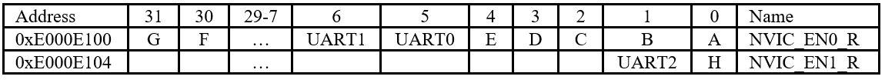
NVIC_Enx_R
There are five enable registers defining 139 interrupt enable bits.
Each one is 32 bits, takes care of 32 interrupts:
  NVIC_EN0_R controls the IRQ numbers 0 to 31.
  NVIC_EN1_R controls the IRQ numbers 32 to 63.
  NVIC_EN2_R controls the IRQ numbers 64 to 95.
  NVIC_EN3_R controls the IRQ numbers 96 to 127.
  NVIC_EN4_R controls the IRQ numbers 128 to 138.
  Observation: There are many interrupt sources, but an effective system will use only a few.
CECS347
Notes:
There are five enable registers NVIC_EN0_R through NVIC_EN4_R. The 32 bits in register NVIC_EN0_R control the IRQ numbers 0 to 31 (interrupt numbers 16 – 47). In Table 12.1 we see UART0 is IRQ=5. To enable UART0 interrupts we set bit 5 in NVIC_EN0_R, see Table 12.3. The 32 bits in NVIC_EN1_R control the IRQ numbers 32 to 63 (interrupt numbers 48 – 79). In Table 12.1 we see UART2 is IRQ=33. To enable UART interrupts we set bit 1 (33-32=1) in NVIC_EN1_R, see Table 12.3. Not every interrupt source is available on every TM4C microcontroller, so you will need to refer to the data sheet for your microcontroller when designing I/O interfaces. Writing zeros to the NVIC_EN0_R through NVIC_EN4_R registers has no effect. To disable interrupts we write ones to the corresponding bit in the NVIC_DIS0_R through NVIC_DIS4_R register.

Slide 21
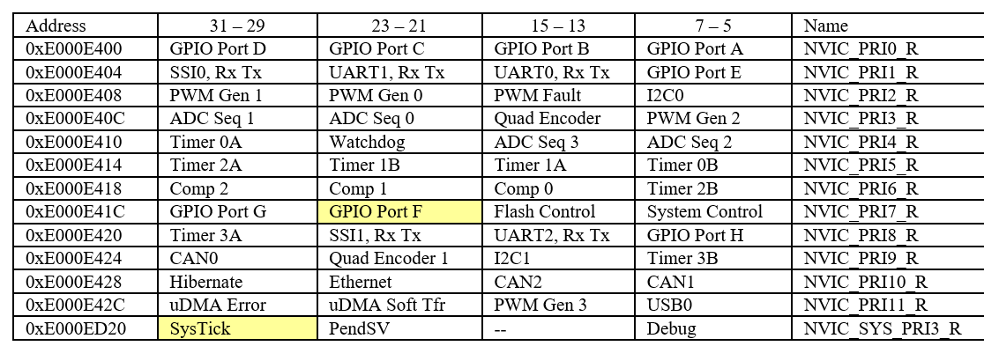
Priority Register: NVIC_PRIx_R
Each register contains an 8-bit priority field for four devices.
On the TM4C microcontrollers, only the top three bits of the 8-bit field are used: allow priority level 0 to 7, with 0 being the highest priority.
A higher priority interrupt can suspend the execution of a lower priority ISR.
CECS347
Notes:
A nested interrupt occurs when a higher priority interrupt suspends an ISR. The lower priority interrupt will finish after the higher priority ISR completes.
Priority determines the order of service when two or more requests are made simultaneously. Priority also allows a higher priority request to suspend a lower priority request currently being processed. Usually, if two requests have the same priority, we do not allow them to interrupt each other. NVIC assigns a priority level to each interrupt trigger. This mechanism allows a higher priority trigger to interrupt the ISR of a lower priority request. Conversely, if a lower priority request occurs while running an ISR of a higher priority trigger, it will be postponed until the higher priority service is complete.
To activate an interrupt source we need to set its priority and enable that source in the NVIC. This activation is in addition to the arm and enable steps. Table 9.1 in the textbook lists some of the interrupt sources available on the TM4C family of microcontrollers. Interrupt numbers 0 to 15 contain the faults, software interrupt and SysTick; these interrupts will be handled differently from interrupts 16 and up.
Table 9.2 shows some of the priority registers on the NVIC. Each register contains an 8-bit priority field for four devices. On the TM4C microcontrollers, only the top three bits of the 8-bit field are used. This allows us to specify the interrupt priority level for each device from 0 to 7, with 0 being the highest priority. The interrupt number (number column in Table 9.1) is loaded into the IPSR register. The servicing of interrupts does not set the I bit in the PRIMASK, so a higher priority interrupt can suspend the execution of a lower priority ISR. If a request of equal or lower priority is generated while an ISR is being executed, that request is postponed until the ISR is completed. In particular, those devices that need prompt service should be given high priority.

Slide 22
SysTick Periodic Interrupt
The SysTick timer is a simple way to create a periodic interrupt that is requested on a fixed time basis.
When the SysTick counter goes from 1 to 0, the Count flag in the NVIC_ST_CTRL_R register is set, triggering an interrupt.See datasheet P.139.
On the next clock, the CURRENT is loaded with the RELOAD value.
If the RELOAD value is n, then it rolls over every n+1 counts.
Notice there is no explicit software step in the ISR to clear the COUNT flag.
CECS347
Notes:
When the CURRENT value counts down from 1 to 0, the COUNT flag is set. On the next clock, the CURRENT is loaded with the RELOAD value. In this way, the SysTick counter (CURRENT) is continuously decrementing. If the RELOAD value is n, then the SysTick counter operates at modulo n+1 (…n, n-1, n-2 … 1, 0, n, n-1, …). In other words, it rolls over every n+1 counts. Thus, the COUNT flag will be set every n+1 counts. Program 12.5 shows a simple example of SysTick. SysTick is the only interrupt on the TM4C that has an automatic acknowledge. Notice there is no explicit software step in the ISR to clear the COUNT flag.

Slide 23
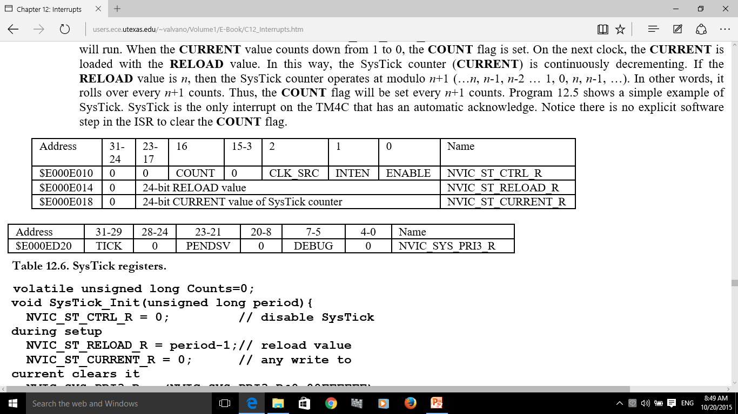

Setup SysTick Registers
In Main:
NVIC_ST_CTRL_R = 0; // disable SysTick during setup
NVIC_ST_RELOAD_R = period-1;// reload value
NVIC_ST_CURRENT_R = 0; // any write to current clears it
NVIC_SYS_PRI3_R=(NVIC_SYS_PRI3_R&0x1FFFFFFF)|0x40000000;//priority 2
NVIC_ST_CTRL_R = 0x07; // enable SysTick with core clock & interrupts
EnableInterrupts();// enable interrupts after all initialization is finished
In ISR: No need to acknowledge. SysTick is the only interrupt on the TM4C that has an automatic acknowledge.
CECS347
Notes:
SysTick has a 24-bit counter that decrements at the bus clock frequency. Let f_{BUS} be the frequency of the bus clock, and let n be the value of the RELOAD register. The frequency of the periodic interrupt will be f_{BUS}/(n+1). First, we clear the ENABLE bit to turn off SysTick during initialization. Second, we set the RELOAD register. Third, we write any value to NVIC_ST_CURRENT_R to clear the counter. Lastly, we write the desired mode to the control register, NVIC_ST_CTRL_R. We must set CLK_SRC=1, because CLK_SRC=0 external clock mode is not implemented on the LM3S/TM4C family. We set INTEN to enable interrupts. We establish the priority of the SysTick interrupts using the TICK field in the NVIC_SYS_PRI3_R register. We need to set the ENABLE bit so the counter will run. When the CURRENT value counts down from 1 to 0, the COUNT flag is set. On the next clock, the CURRENT is loaded with the RELOAD value. In this way, the SysTick counter (CURRENT) is continuously decrementing. If the RELOAD value is n, then the SysTick counter operates at modulo n+1 (…n, n-1, n-2 … 1, 0, n, n-1, …). In other words, it rolls over every n+1 counts. Thus, the COUNT flag will be set every n+1 counts. Program 12.5 shows a simple example of SysTick. SysTick is the only interrupt on the TM4C that has an automatic acknowledge. Notice there is no explicit software step in the ISR to clear the COUNT flag.

Slide 24
C12_PeriodicSysTickInts
volatile unsigned long Counts = 0;
void SysTick_Init(unsigned long period){
NVIC_ST_CTRL_R = 0; // disable SysTick during setup
NVIC_ST_RELOAD_R = period-1;// reload value
NVIC_ST_CURRENT_R = 0; // any write to current clears it
// priority 2
NVIC_SYS_PRI3_R = (NVIC_SYS_PRI3_R&0x00FFFFFF)|0x40000000;
// enable SysTick with core clock and interrupts
NVIC_ST_CTRL_R = 0x07;
EnableInterrupts();
}
// Interrupt service routine: Executed every 62.5ns*(period)
void SysTick_Handler(void){
GPIO_PORTF_DATA_R ^= 0x04; // toggle PF2
Counts = Counts + 1;
}
CECS347

Slide 25
ISR: To Do & Not To Do
Do:
  Acknowledge: software clear the interrupt flag
  Make sure it is Short
Not to Do:
  Delay loops
  ISR execution longer than time between triggers
CECS347
Notes:
An axiom with interrupt synchronization is that the ISR should execute as fast as possible. The interrupt should occur when it is time to perform a needed function, and the interrupt service routine should perform that function, and return right away. Placing backward branches (busy-wait loops, iterations) in the interrupt software should be avoided if possible. The percentage of time spent executing interrupt software should be small when compared to the time between interrupt triggers.

Slide 26
Inter-Thread Communication
Main thread vs. background thread
Three ways to communicate
  Flag
  Mailbox
  Buffers, such as FIFO
CECS347

Slide 27
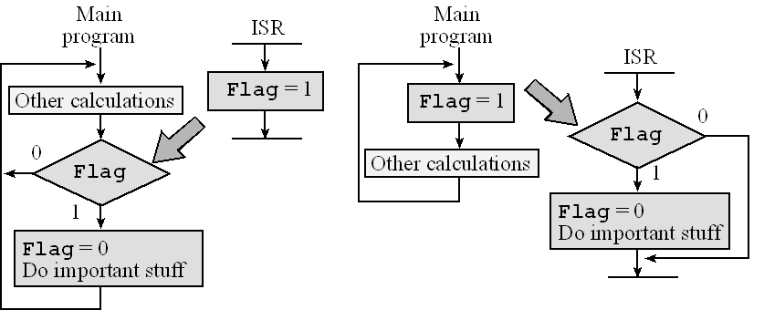
Inter-Thread Communication
Flag
CECS347

Slide 28
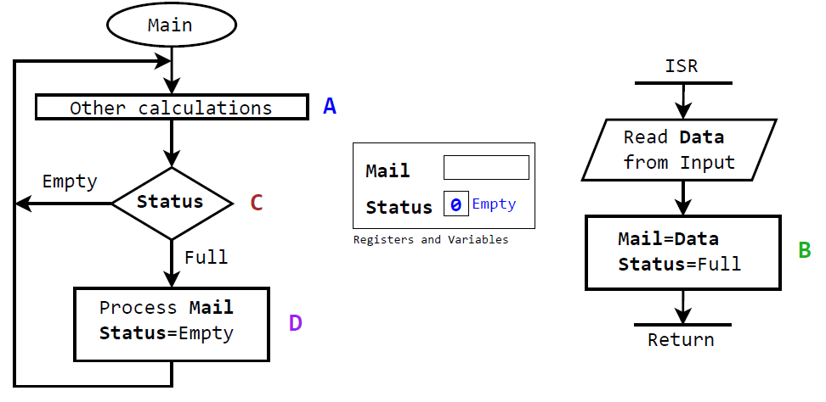
Inter-Thread Communication
Mailbox
CECS347

Slide 29
References
Textbook Chapter 9: 9.1 – 9.6
Example Projects in TExaSware: C12_EdgeInterrupt, C12_PeriodicSysTickInts,
C12_SoftSound
C12_DCMotor
UT Austin EE 319K Lecture 7
CECS347

